Slide 1
Lecture 2: COMP1010 Introduction to Python
Python Setup, Values, Data Types, Expression, & Operators
Pham Huy Hieu and Kok-Seng Wong | Fall 2025
College of Engineering and Computer Science, VinUniversity
September 17th, 2025

Slide 2

Motivational example 1
Transactions (Balance Inquiry, PIN Change, Deposit, Transfer, etc.)
Account Information (Account Types, Name, Account Balance, etc.)
Continue? (Yes / No)
Enter PIN Number
[source]

Slide 3
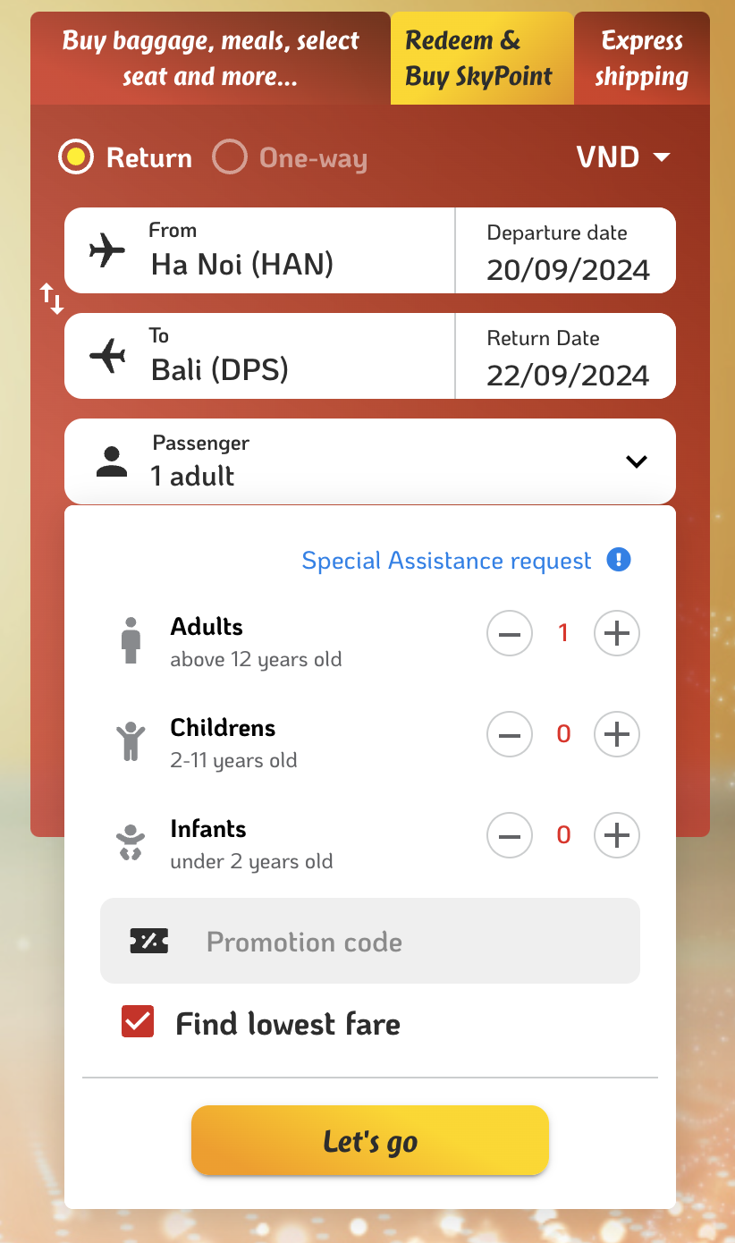
Motivational example 2
Binary Option
Specific Format
Counter
Specific Condition

Slide 4
OUTLINE: PLAN FOR TODAY
Python setup
IDEs for Python (Spyder, Jupyter, Visual Studio Code, PyCharm)
Write your first program in Python (“Hello, World!”)
Python operators, expressions, values, and data types
Class practice

Slide 5
Learning outcomes
Upon the completion of this lecture, students will be able to:
complete the setup of Python IDEs.
understand the distinction of different Python IDEs.
understand and able to use different data types, operators and expressions.

Slide 6
Python setup

Slide 7
Python Environment
Python: one (of many other) programming languages we will be using. It is the language we will write computer programs in.
CUI/IDEL: basic interactive shell to execute a single Python command.
IPython: a computer application that provides a convenient and interactive mode for executing Python commands.
Jupyter notebook: a web-based application that allows to run IPython in the browser.
PyCharm: code inspections, on-the-fly error highlighting and quick-fixes, along with automated code refactorings and rich navigation.

Slide 8
Python Environment
NumPy: a standard library that provides numerical arrays and mathematical functions.
Pandas: pandas stands for “Python Data Analysis Library”.
Matplotlib and PyPlot: modules that provides visualization tools.

Slide 9
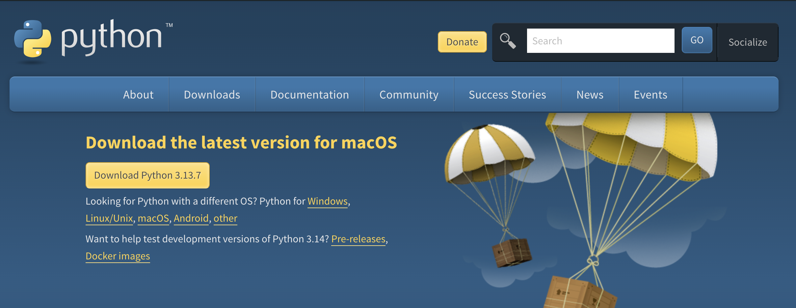
Python 3 installation
https://www.python.org/

Slide 10
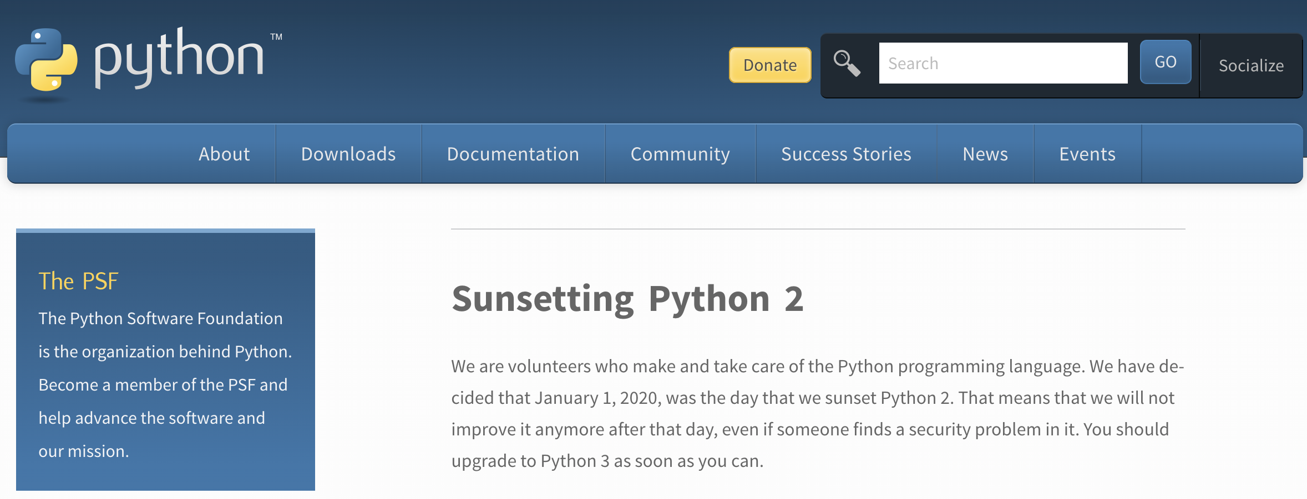


Python 3 installation
Python 2 reached its official end of support on January 1, 2020.
Python 2 should only be learned for maintaining legacy systems and not for new projects.
Python 3 is the only version being developed, updated, and recommended for use.

Slide 11
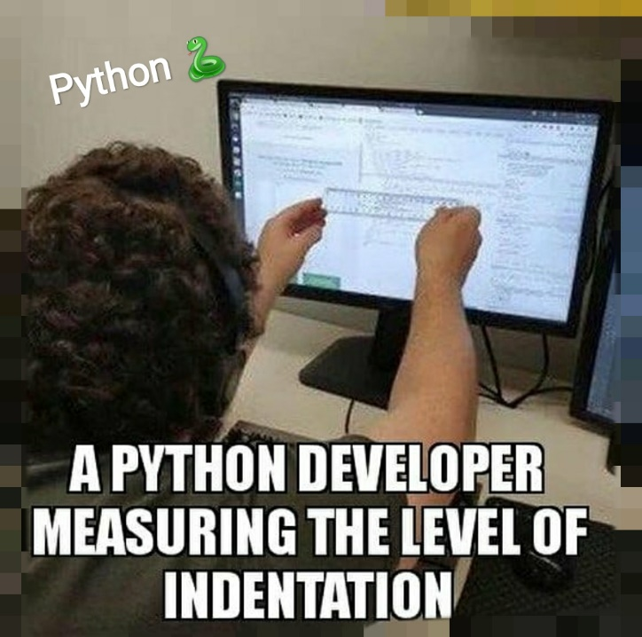
IDE
Integrated Development Environment
IDE is an application that provides:
  A text editor with syntax highlighting, auto completion, and smart indentation
  A shell with syntax highlighting
  An integrated debugger
[source]

Slide 12
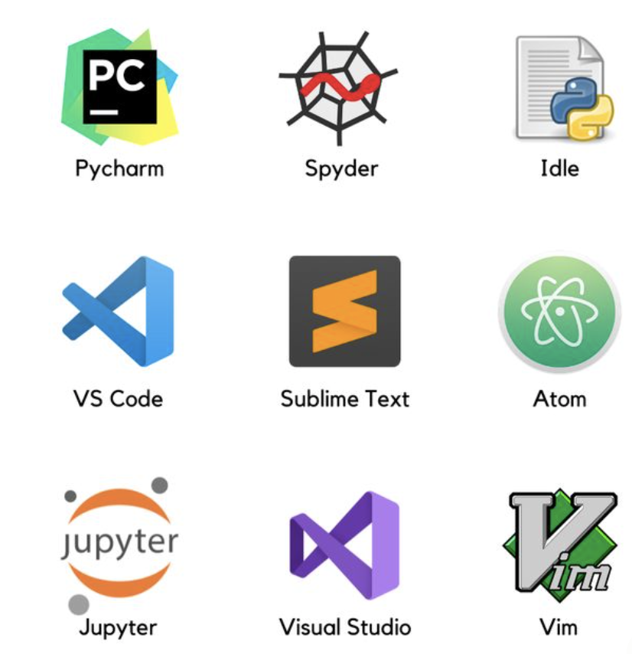
ide for python

Slide 13
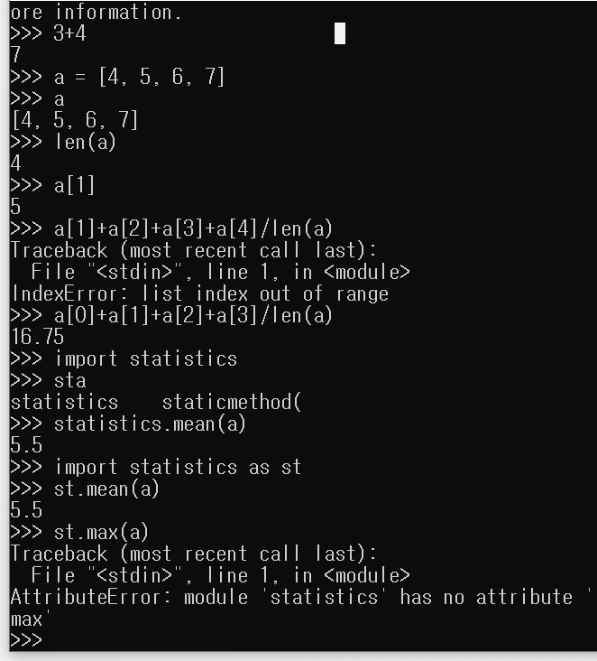
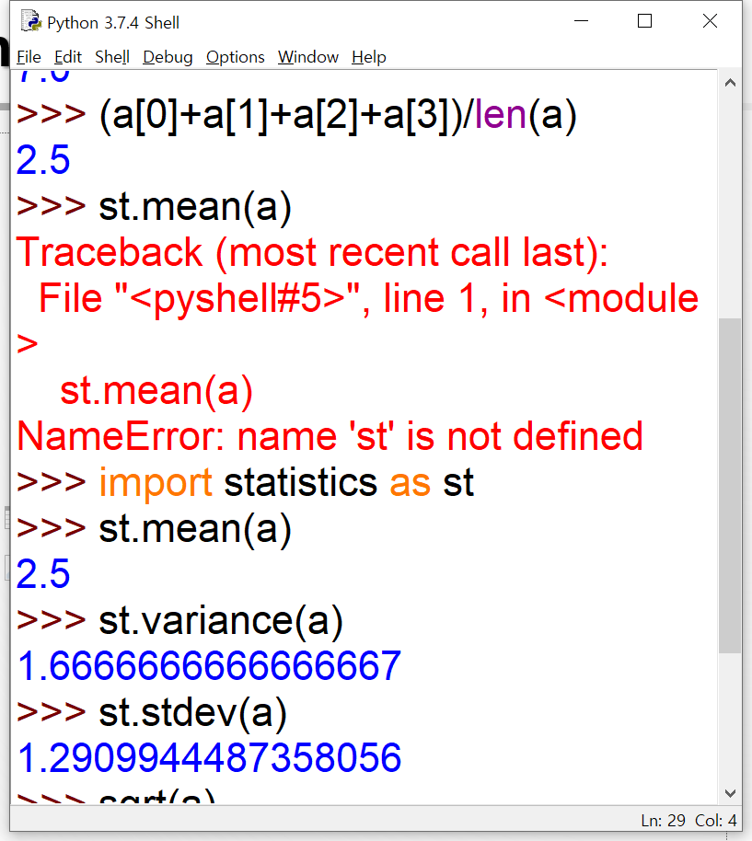
ide for python
IDEL CUI
(Command Line User Interface)
IDEL Shell
(Interactive shell)

Slide 14
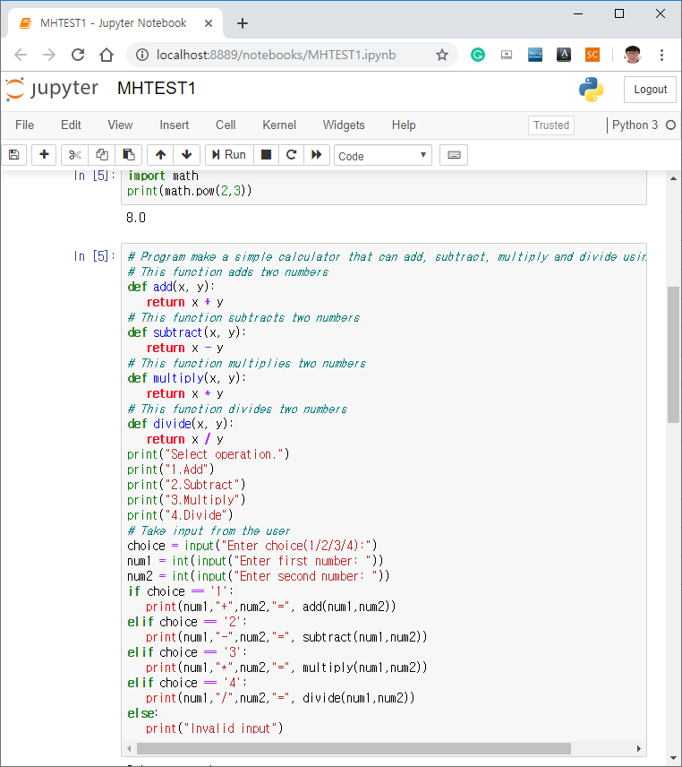
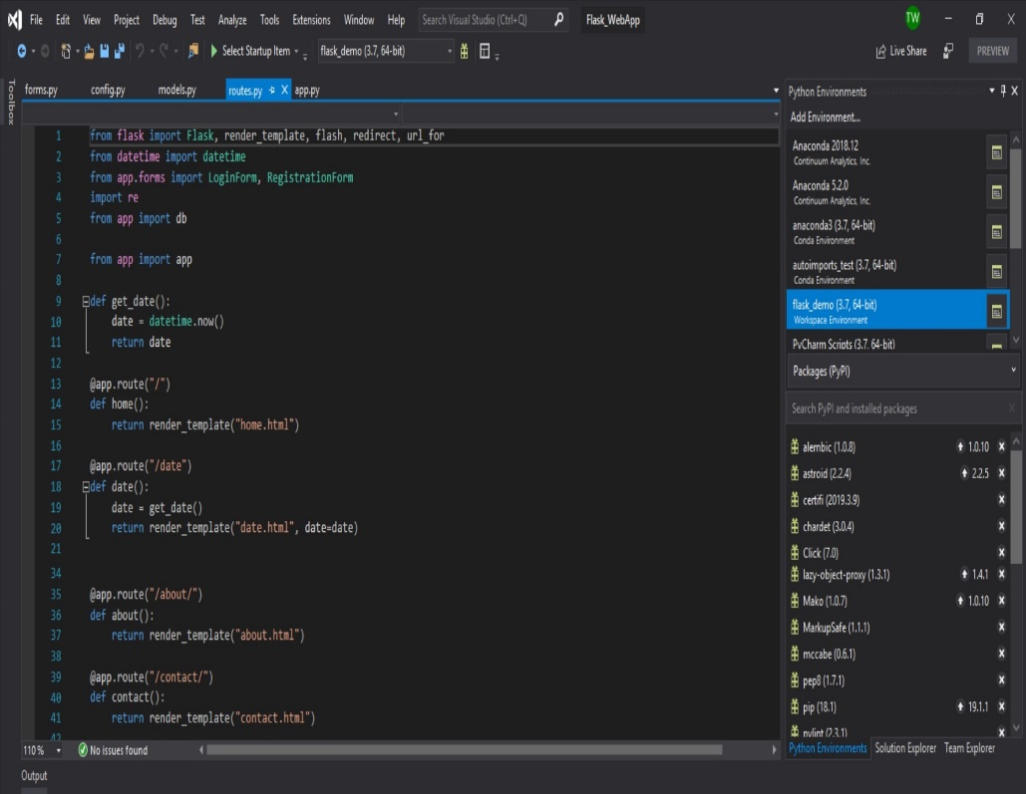
ide for python: JupYter and Visual studio code
Jupyter notebook
Visual studio code
Jupyter Notebook is an open-source, web-based application for creating and sharing "computational documents". These interactive documents, called notebooks, allow you to combine live code, equations, visualizations, and narrative text in a single, shareable file.
Visual Studio Code is a source-code editor that can be used with a variety of programming languages, including C, C#, C++, Fortran, Go, Java, JavaScript, Node.js, Python. Features include support for debugging, syntax highlighting, intelligent code completion, snippets, code refactoring, and embedded version control with Git.

Slide 15
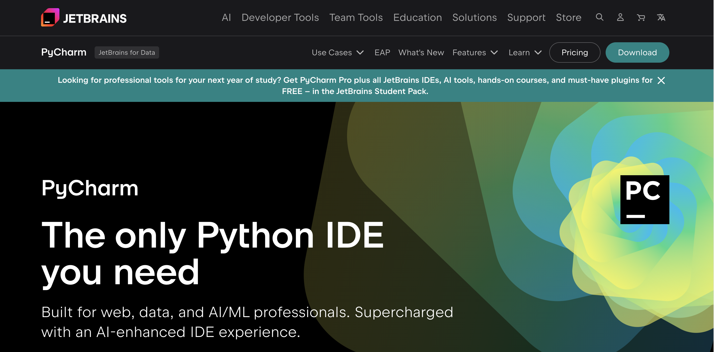
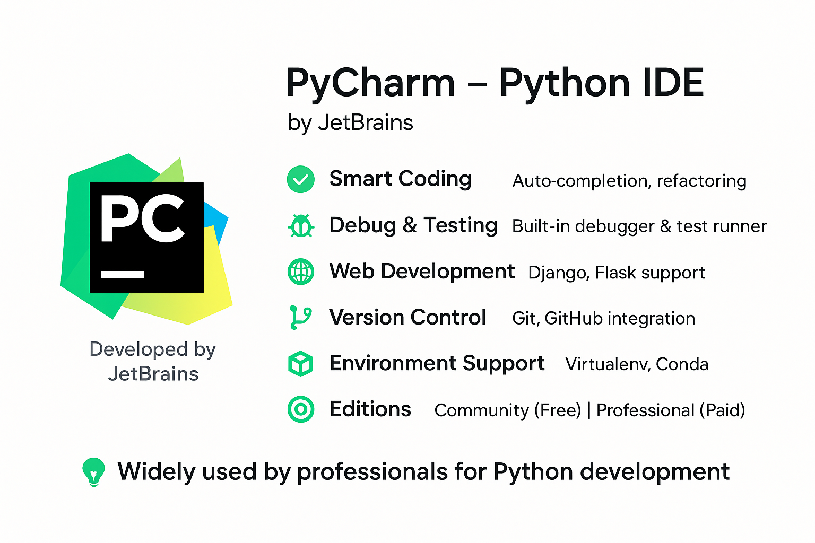
ide for python: Pycharm
Pycharm is the most popular Python IDE. It includes great features such as excellent code completion and inspection with advanced debugger. In this course, we will use PyCharm as the official IDE for labs and coding assignments.
https://www.jetbrains.com/pycharm/

Slide 16
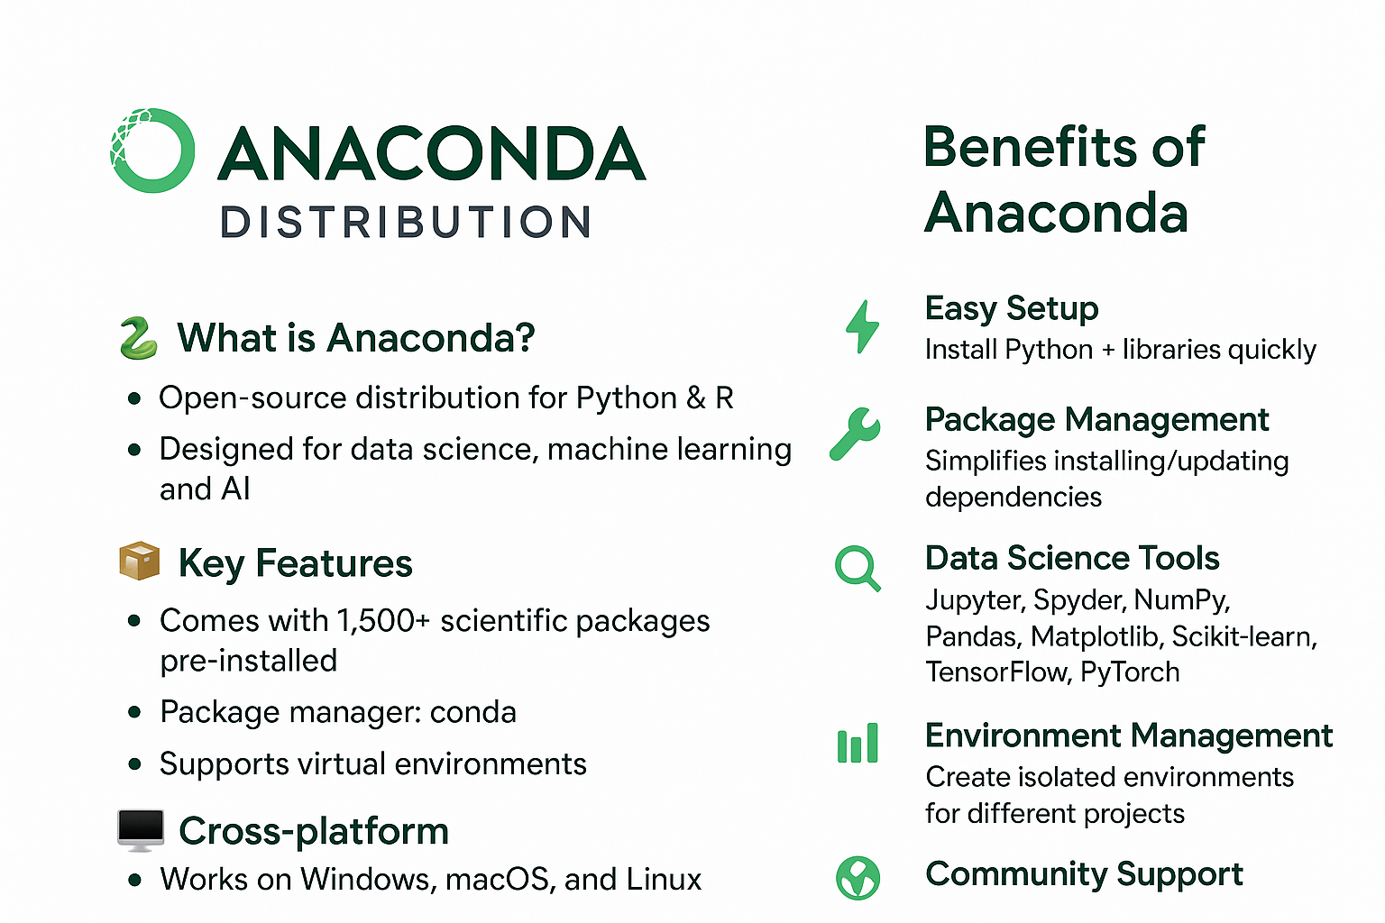
ide for python: Anaconda
Anaconda is an open-source distribution and platform designed for data science, machine learning, and AI, which provides a convenient way to manage Python and R packages and environments.
It includes a powerful package and environment manager called conda, the graphical user interface Anaconda Navigator.
https://www.anaconda.com/

Slide 17
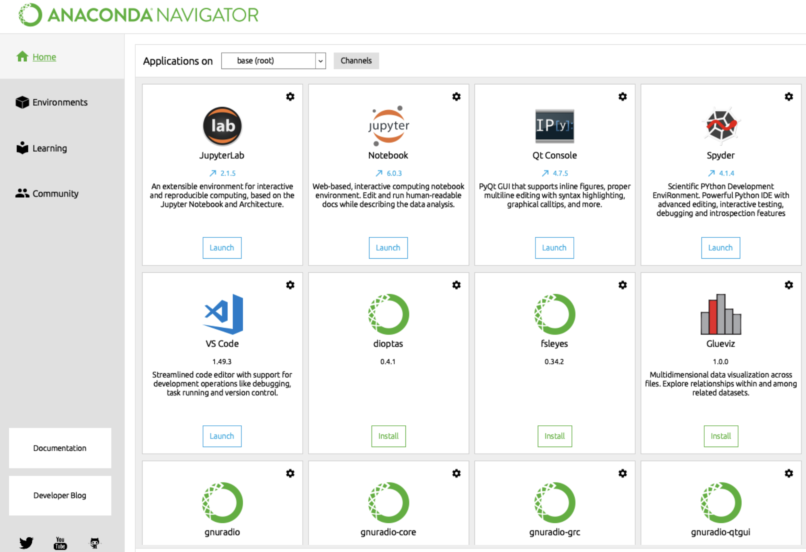
ide for python: Anaconda

Slide 18
Write your first python program!
Try online Python IDE at
https://www.online-python.com/
https://www.programiz.com/python-programming/online-compiler/

Slide 19
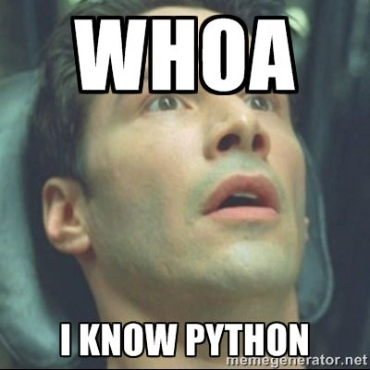
The first program
The quotation marks in the program mark the beginning and end of the value.
They do not appear in the result.
Supports single or double quotes:
Output:
print ("Hello, World!")
Hello, World!
print ('Hello, World!')

Slide 20
comments
Comments: notes to your programs to explain in natural language what the program is doing.
single comment
#This is a comment
print("Hello, World!")
print("Hello, World!") #This is a comment
multiline comment
#This is a comment
#written in
#more than just one line
print("Hello, World!")
"""
This is a comment
written in
more than just one line
"""
print("Hello, World!")

Slide 21
Python operators
Arithmetic operators
Assignment operators
Comparison operators
Logical operators
Identity operators
Membership operators
Bitwise operators

Slide 22
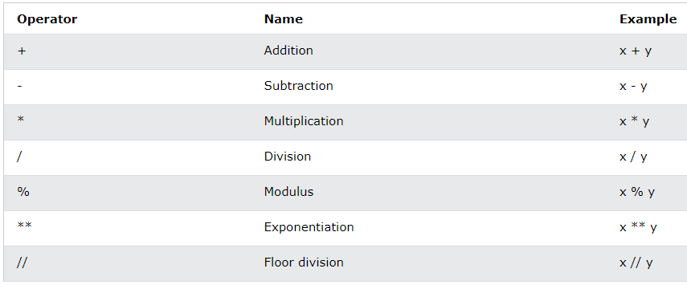
Arithmetic operators
Arithmetic operators are used with numeric values to perform common mathematical operations:
[source]
Notes:
Modulus – this gives the remainder of a division
Exponentiation – raising a number to a power (x ** y)
Floor Division – dividing and then taking only the integer part (x // y)

Slide 23
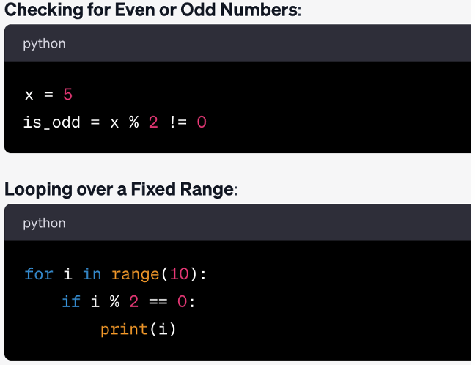
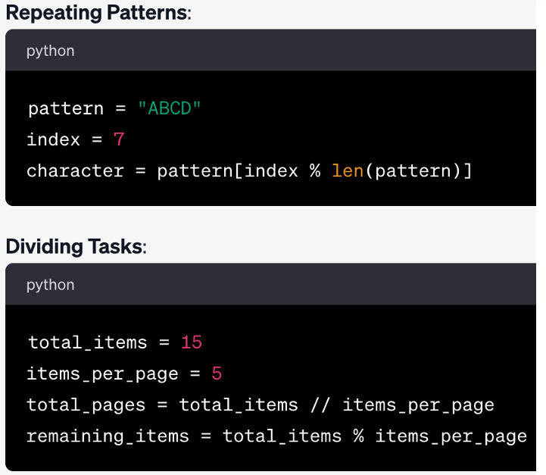
Modulus (%) operator examples

Slide 24
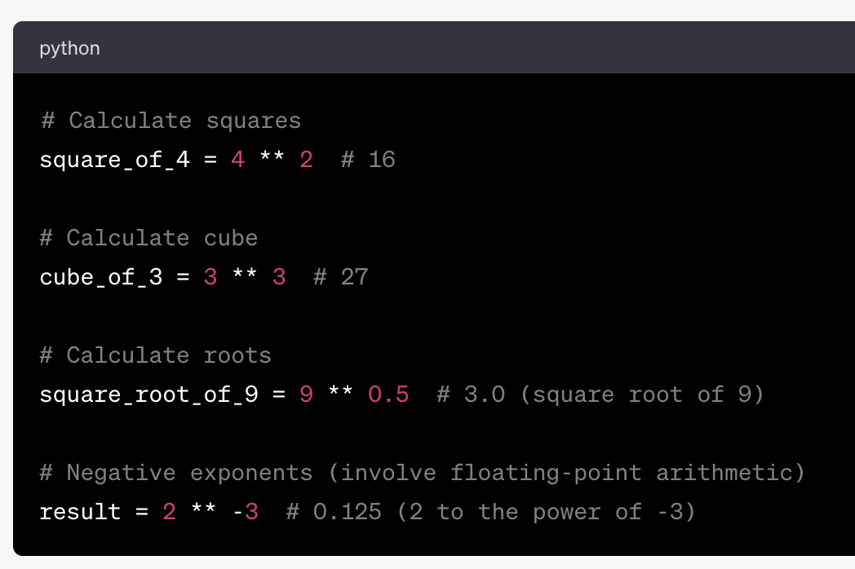

Exponential (**) operator examples

Slide 25
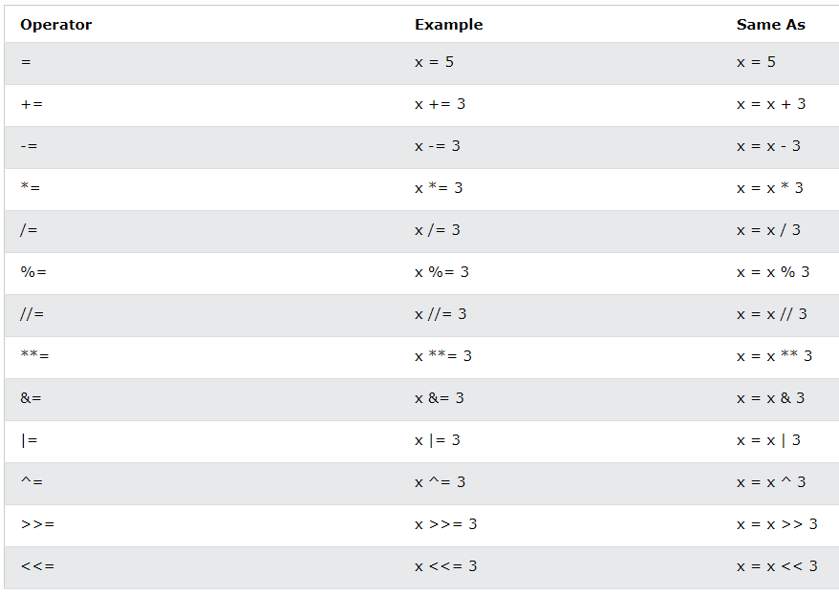
Assignment operators
Assignment operators are used to assign values to variables:
[source]

Slide 26
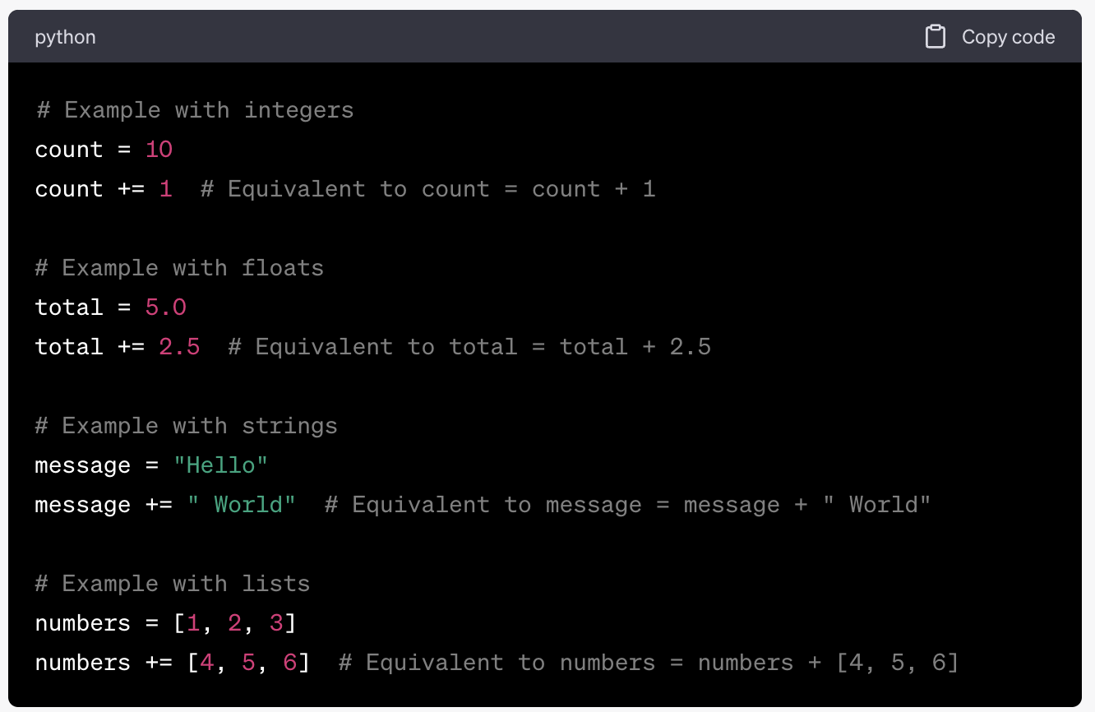
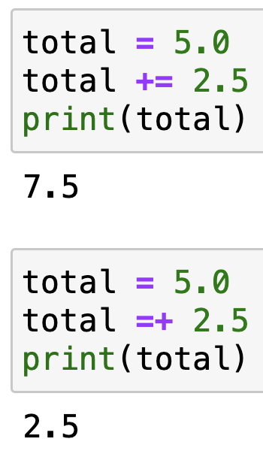
(+=) operator examples

Slide 27
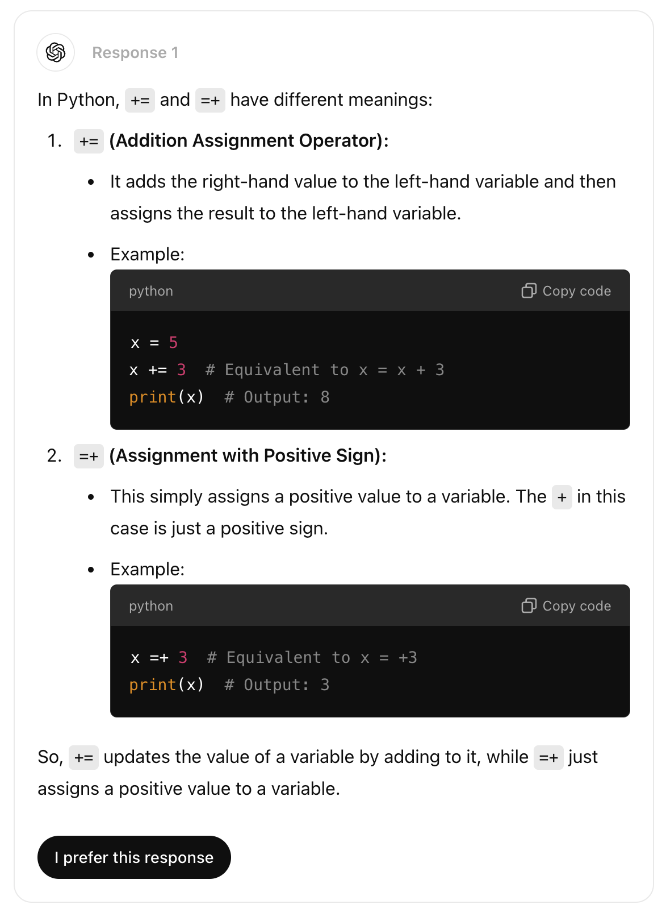
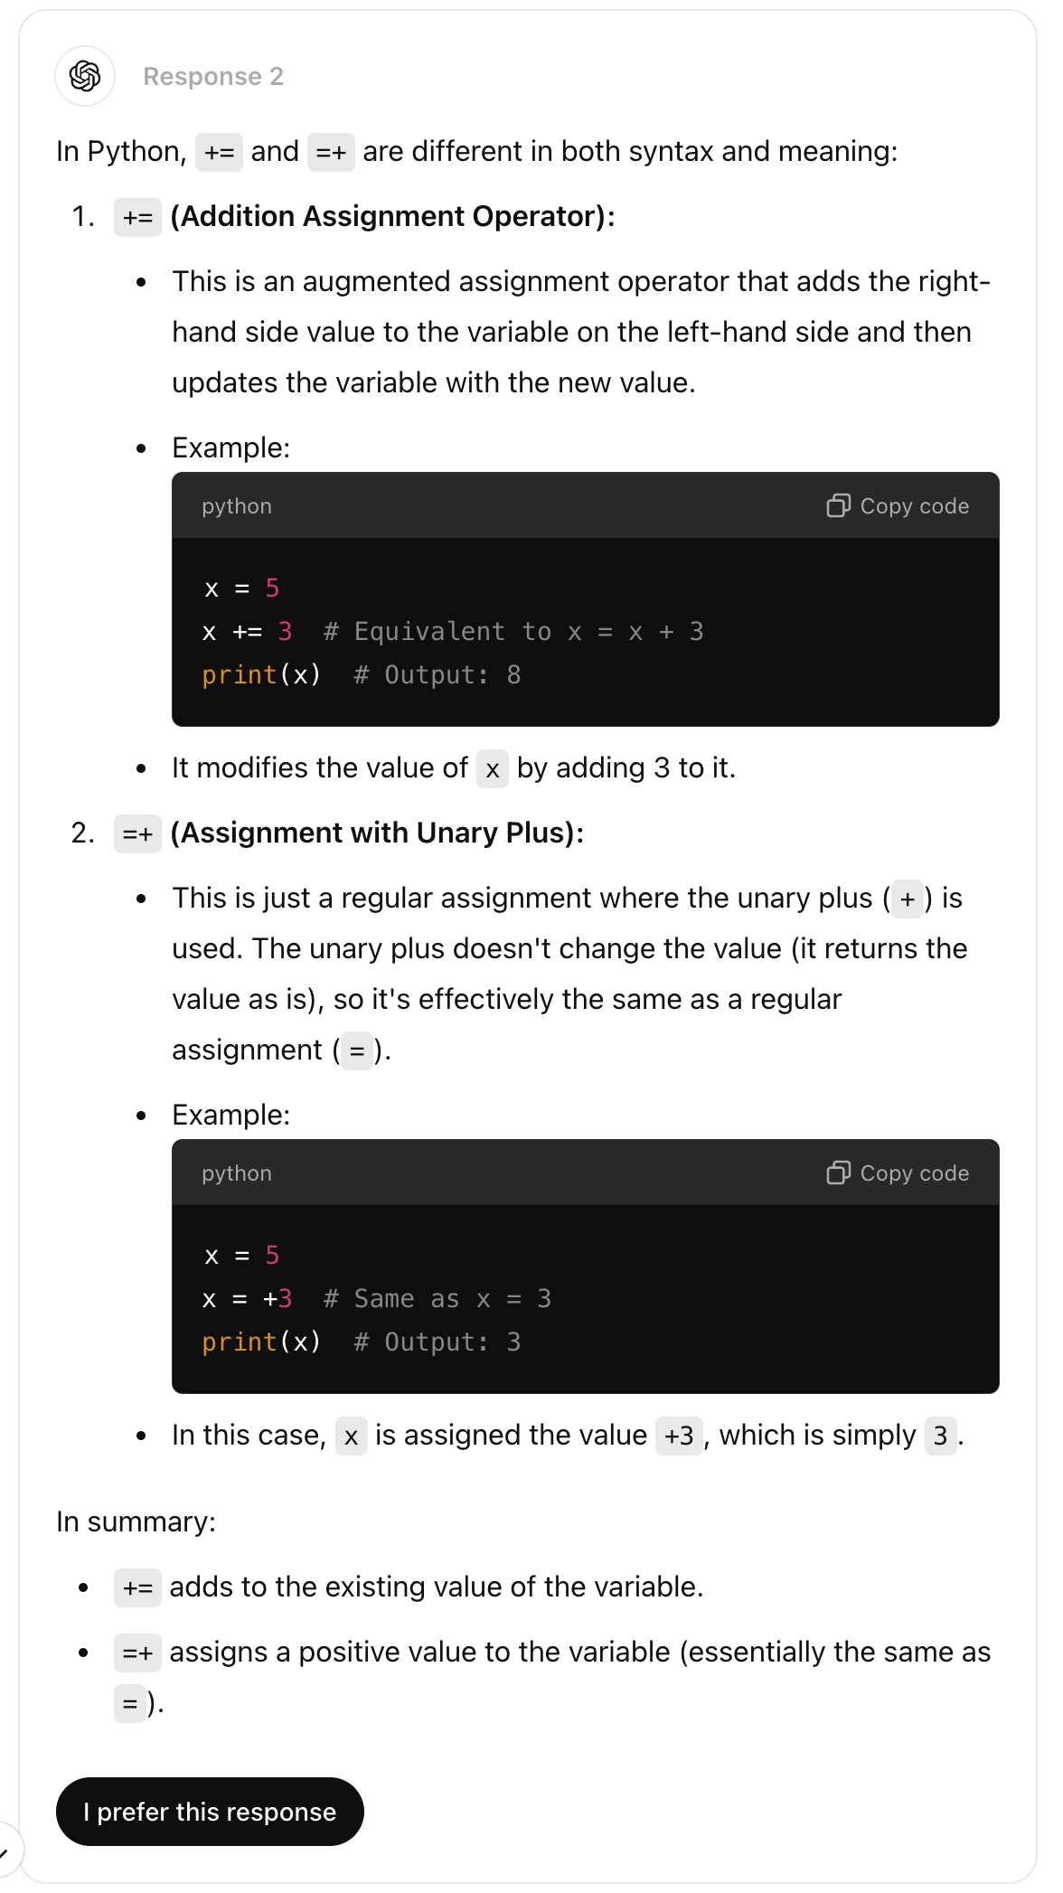

Slide 28
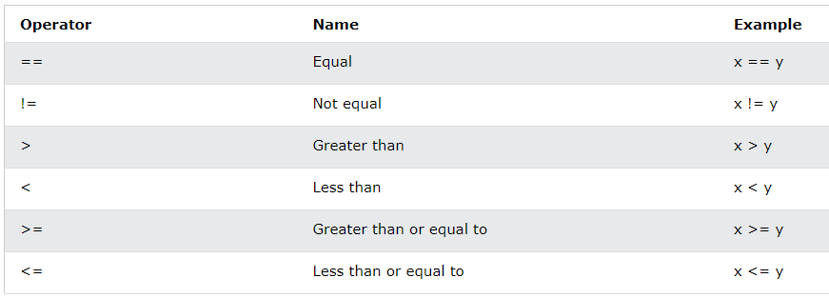
Comparison operators
Comparison operators are used to compare two values:
[source]

Slide 29
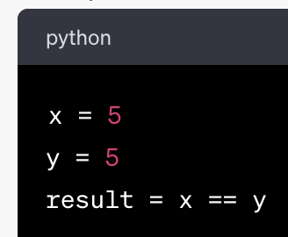
(==) operator example
This assigns the value 5 to the variable x.
# This will result in True because x and y have the same value (5).

Slide 30
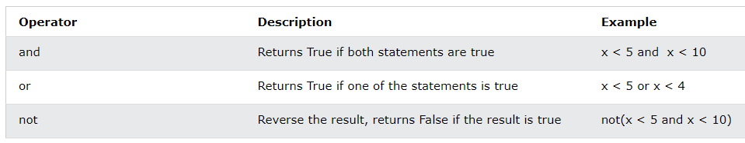
Logical operators
Logical operators are used to combine conditional statements:
[source]

Slide 31
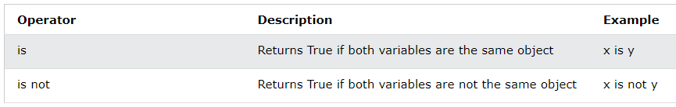
identity operators
Identity operators are used to compare the objects, not if they are equal, but if they are actually the same object, with the same memory location:
[source]

Slide 32
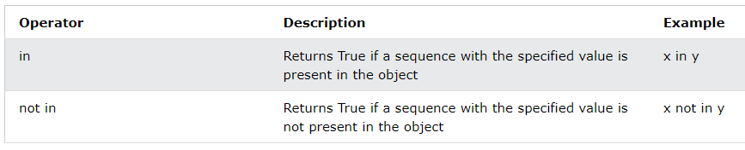
Membership operators
Membership operators are used to test if a sequence is presented in an object:
[source]

Slide 33
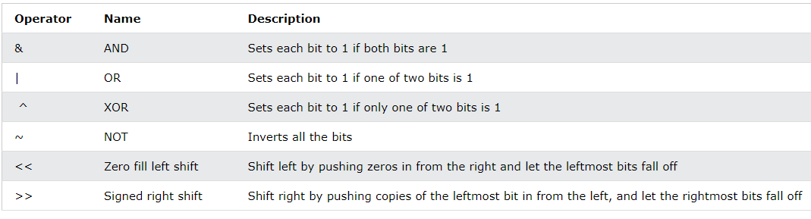
Bitwise operators
Bitwise operators are used to compare (binary) numbers:
[source]

Slide 34
expressions
An expression is something (e.g., a number, a string, or an instance of a class) that Python will evaluate on it.
Any value is an expression!
3.142
Literal (evaluates to self)
"Hello"
String represents the value of the string
4+(5*6)*0.1
With four literals and some operators

Slide 35
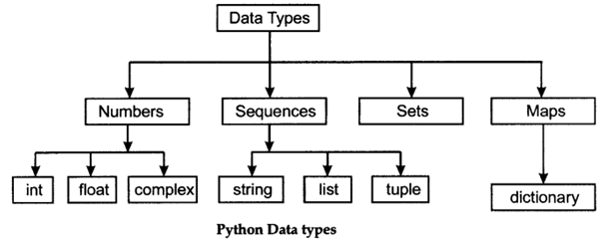
Values & data types
A value is one of the fundamental things: a letter or a number that a program manipulates.
A type is a set of values and the operations (+, -, /, *) on these values.
10, 7/3, "Hello"

Slide 36
Integers (int)
Values: …, -10, -6, 0, 3, 9, 3434, 10300493, …
Operations: +, -, *, /, **, //, %,
Modulus: returns the remainder when first operand is divided by the second
Division (floor): divide the first operand by the second

Slide 37
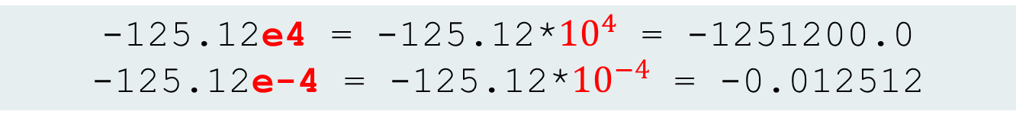
floating point (float)
Values: (approximations of) real numbers
Operations: +, -, *, /, **, unary -
Exponent notation: for large or small values
Consider the fraction 1/3
0.3, 0.33, 0.333, 0.3333, …
float literal examples:
3.22, 70.14
Power: returns first raised to power second
-125.12e4 = -125.12*${10}^{4}$ = -1251200.0
-125.12e-4 = -125.12*${10}^{−4}$ = -0.012512

Slide 38
Floating point representation errors
Python stores floats as binary (base-2) fractions.
When combined in expressions, the representation error can get worse:
To “see” the exact value that’s stored in any particular Python float:
>>> 0.1 + 0.2
0.30000000000000004
>>> 0.11 + 0.12
0.22999999999999998
>>> 6 * 0.1
0.6000000000000001
>>> round(2.675,2)
2.67
Round the value 2.675 to two decimal places
>>> from decimal import Decimal
>>> Decimal(2.675)
Decimal('2.67499999999999982236431605997495353221893310546875')>>>

Slide 39
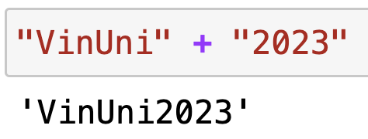
String (str): concatenation
Values: any sequence of characters
Operations: + (concatenation)
String literal: sequence of characters in single or double quotes
Concatenation rules:
empty string
"Hello World!" or 'Hello World!'
"" or ''
>>> "Vin"+"Uni"
'VinUni'
>>> "VinUni"+2023
Traceback (most recent call last): File "<stdin>", line 1, in <module>
TypeError: can only concatenate str (not "int") to str

Slide 40
String (str): shallow copy
Operations: *
Shallow copy rule: str * int
>>> Halo*10
Traceback (most recent call last):
File "<pyshell#0>", line 1, in <module>
Halo*10
NameError: name 'Halo' is not defined
>>> "halo"*10
'halohalohalohalohalohalohalohalohalohalo'

Slide 41
>>> "Hello" + "World!"
out1
>>> "Hello" + " World!"
out2
>>> "Hello " + "World!"
out3
>>> "Hello" + " " + "World!"
out4

Slide 42
Boolean(Comparison operators)
values: True, False
operator: ==, !=, <, <=, >, >=
>>> a = 10
>>> b = 10.2
>>> a < b
True
>>> a <= b
True
>>> a >= b
False
>>> a > b
False
>>> a == b
False
>>> a != b
True
>>> print("Ali" == "Baba")
False
>>> print("Ali" == "ali")
False
>>> print(100 > 101)
False
>>> print(-5 < -10)
False
>>> print("@" != "#")
True

Slide 43
Boolean (logical operators)
Operations: not, and, or
Operation | True | False
not b | b is false | b is true
b and c | both b and c are true | otherwise
b or c | either b or c is true | otherwise

Slide 44
Boolean logical operator examples
>>> x = 10
>>> print(x < 0 or x > 20)
False
>>> n = 49
>>> print(n%4 == 1 and n%5 == 4)
True
>>> k = 10
>>> print(k**2 > 1000 or k*k == 100)
True
>>> print("Ali" in "Ali Baba")
True
>>> print("Mickey" not in "VinUniversity")
True

Slide 45
Checking data types
Using interpreter to check data types: type(<value>)
Example:
10, 7/3, "Hello"
>>> type(10)
<class 'int'>
>>> type(7/3)
<class 'float'>
>>> type("Hello")
<class 'str'>

Slide 46
Class practice
>>> type(10.2)
>>> type(“10.2”)
>>> type(“1,000,000”)
>>> type(True)
What are the data types?

Slide 47
Class practice
>>> a = 6
>>> b = 3
>>> add = a + b
>>> sub = a - b
>>> mul = a * b
>>> div1 = a / b
>>> div2 = a // b
>>> mod = a % b
>>> p = a ** b
>>> print(add)
>>> print(sub)
>>> print(mul)
>>> print(div1)
>>> print(div2)
>>> print(mod)
>>> print(p)

Slide 48
Lecture 03: VARIABLES and OPERATORS
Thank you for your attendance!

